Slide 1
ESG Reporting Update
Robert Hirth, Senior Managing Director, SASB Board member
Robert B. Hirth, Jr.
Protiviti
Senior Managing Director
+1.650.291.3393
robert.hirth@Protiviti.com

Slide 2
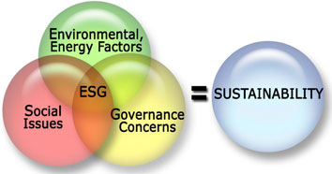

Slide 3
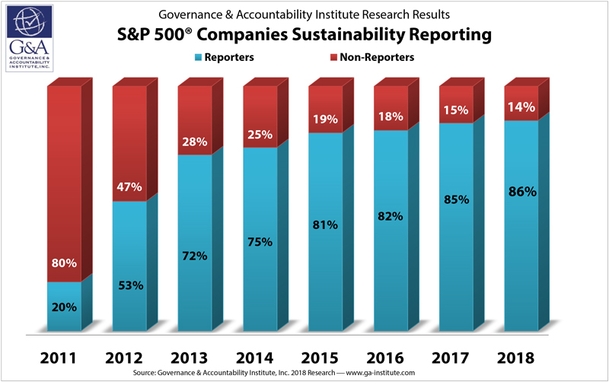

Slide 4

Investor Interest in Sustainability-related Information
Resorting to costly and time-intensive means to obtain ESG information
SHAREHOLDER PROPOSALS
75%
67%
Percent of total proposals filed that are
related to social and environmental issues
63%
55%
45%
40%
40%
2011 2012 2013 2014 2015 2016 2017
Sources: EY, 2011-2014; As You Sow, 2015, 2016; ISS Analytics 2017
GLOBAL INSTITUTIONAL INVESTORS
89%
67%
50%
Will request sustainability information directly from the company
More likely to consider ESG information if common standards used
“Very likely” to sponsor or co-sponsor a shareholder proposal
Source: PwC, 2014

Slide 5
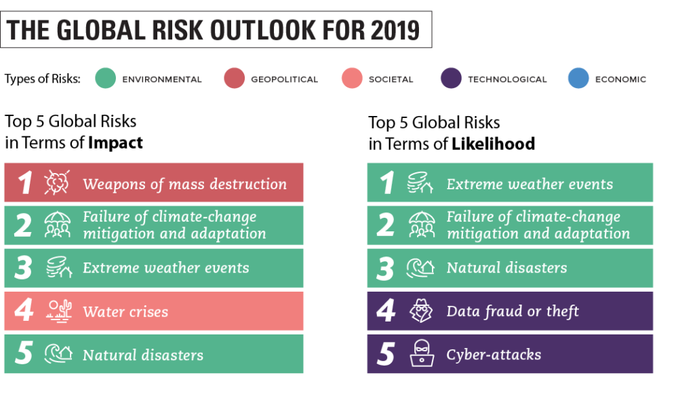

Slide 6
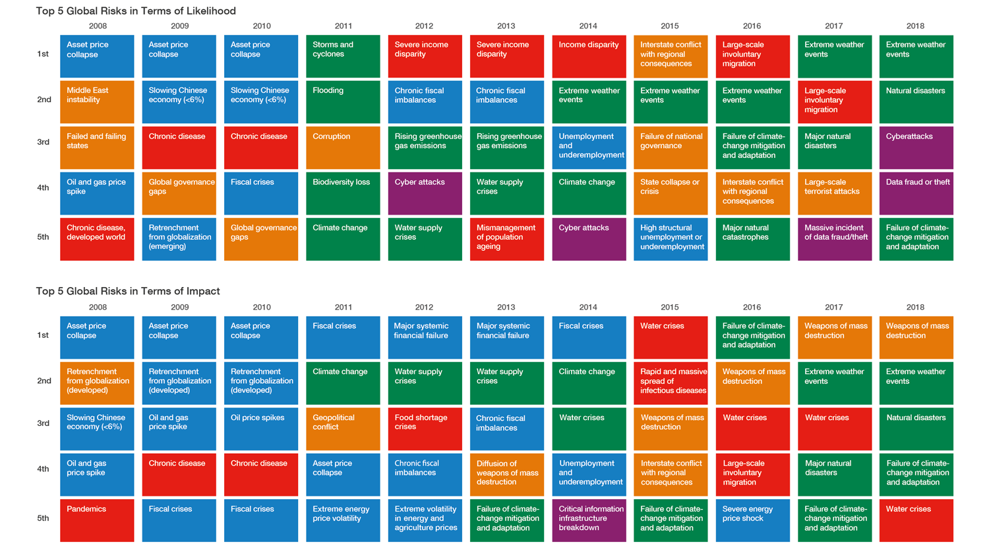

Slide 7
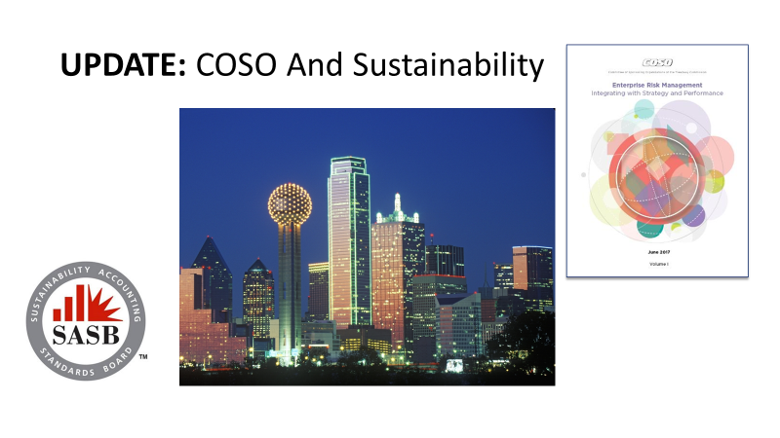

So, What has Changed?
Increased reporting and adoption
New Stock Exchange guidance
COSO ESG/ERM guidance
SEC discussion and proposal mandating ESG reporting
SEC Human Capital disclosure proposal
Inflows to new ESG products
Growing levels of third-party assurance
New Legal considerations
IASB expansion of ESG reporting
SASB standards formally released

Slide 8
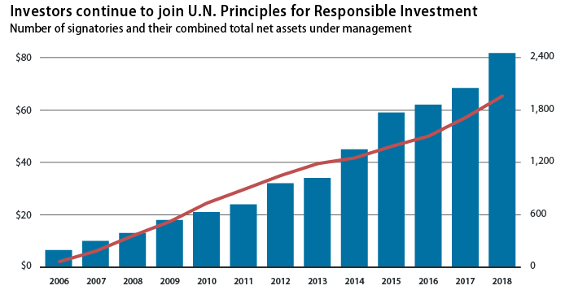

Slide 9

Principles for Responsible
Investment (PRI)
Incorporate ESG issues into investment analysis and decision-making processes.
Be active owners and incorporate ESG issues into our ownership policies and practices.
Seek appropriate disclosure on ESG issues by the entities in which we invest.
Promote acceptance and implementation of the Principles within the investment industry.
Work together to enhance our effectiveness in implementing the Principles.
Report on our activities and progress towards implementing the Principles.

Slide 10

Some Recent Headlines
World's largest pension fund promotes ESG and performance-based fees
Investors want more standardized sustainability disclosures
Does Sustainable Investing Constrain A Portfolio?
Morgan Stanley Adds Credence To Sustainable Returns
PRI gains 500 new signatories in 12 months
Travelers Taps In-House Atty As 1st Sustainability Chief
Making Sense of SEC's Proposed Human Capital Disclosures
Investors Want ESG, but Advisors Are the Missing Link

Slide 11



Nataxis ESG Survey- May 2019
As Consumers
As Investors
63% seek to buy products from companies aligned with their personal values
59% actively avoid buying products from companies that conflict with their personal values
60% actively seek out investments aligned to their values
56% actively seek to avoid investing in companies that conflict with their values

Slide 12

181 CEOs of public companies, including Apple, JPMorgan Chase, and Walmart, have declared a company's purpose is to serve more than just shareholders
It is the first Business Roundtable statement to reject "shareholder primacy," a theory that states that a public company exists solely for the benefit of shareholders and has guided corporate governance for the past four decades.

Slide 13

CEOs of eight Dallas-Fort Worth companies sign on to rethink meaning of shareholder value
Jacobs
Fluor
AT&T
Exxon
McKesson
American Airlines
Texas Instruments
Vistra Equity Partners
Wipro CEO (lives in Coppell)

Slide 14
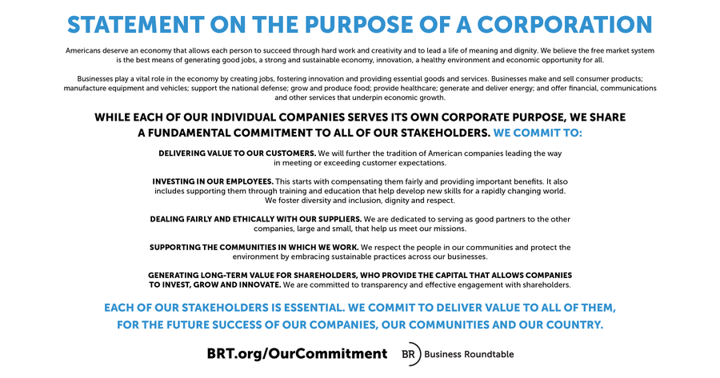

Slide 15

Comerica 2018 ESG Report
We reference topics and metrics contained in the Sustainability Accounting Standards Board (SASB) Sustainability Accounting Standard for Commercial Banks.
We evaluated our current reporting content against the elements of SASB's Commercial Banks standard.
The table below provides the SASB topic, SASB Code, a description of the accounting metric and an indication if we feel that we have met all or a portion of the requirements of the disclosure within the report or other externally published documents and a link or reference to the location of the disclosure. Notes are also included to provide additional context around our disclosure.

Slide 16
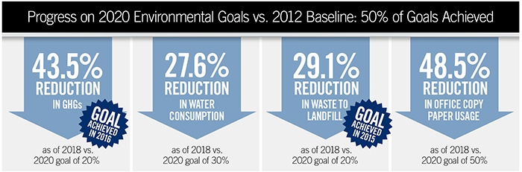

Slide 17

Nasdaq’s ESG Reporting
Guide 2.0- May 2019
A resource for global companies to adopt best-in-class practices to navigate new developments in the field of environmental, social and governance (ESG).
Addresses recent sustainability efforts, including the Sustainability Accounting Standards Board (SASB), the UN Sustainability Development Goals and the Task Force on Non-Financial Climate Disclosures (TCFD), and outlines the latest third-party reporting methodologies.
Aims to stimulate corporate sustainability actions, such as the documentation and management of ESG performance, the integration of ESG indicators in enterprise risk management systems, the disclosure of ESG data and the inclusion of ESG in indexes

Slide 18

COSO, World Business Council for Sustainable Development to Issue First- Ever Guidance for Applying Enterprise Risk Management (ERM) to Environmental, Social, Governance-related Risks
"Business is moving into an era of significant change in corporate governance. Integrating the environmental, social and governance factors into a company’s risk assessment will soon be the norm. New tools are needed for managing this new view of risks to the long-term financial and societal profile of business are needed. Using these tools will mean better decisions that will make more sustainable companies become more successful.“
WBCSD President and CEO Peter Bakker,
January 2018

Slide 19
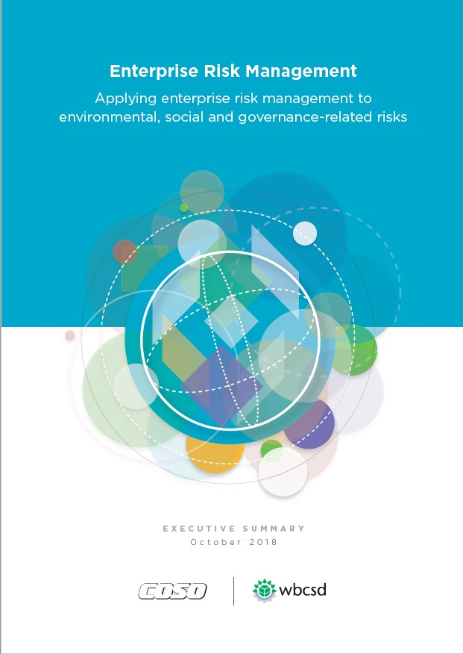
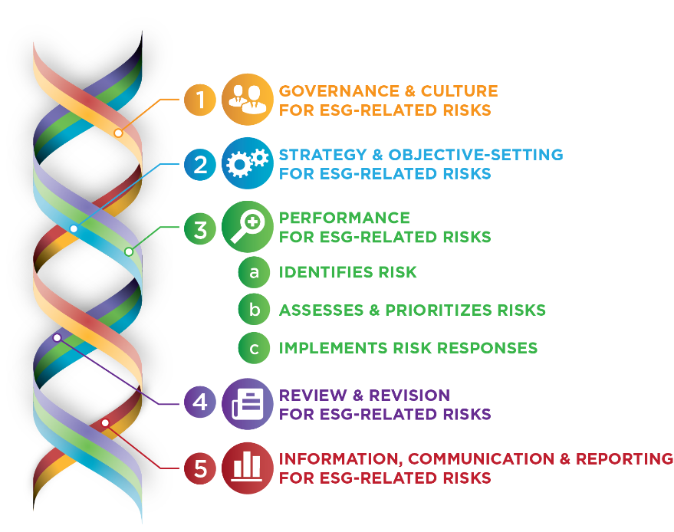
Applying enterprise risk management to environmental, social and governance-related risks

Slide 20

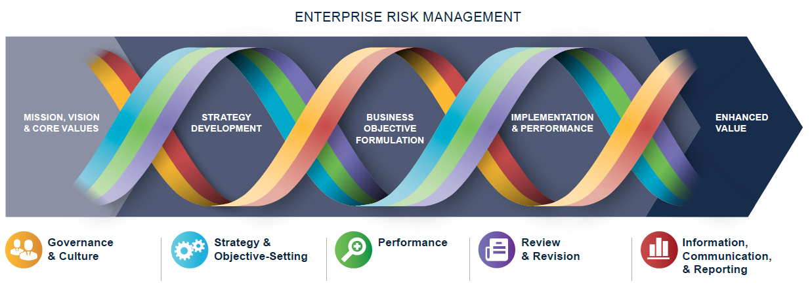
Incorporates New Graphics/Concepts
Graphic has stronger ties to the business model

Slide 21
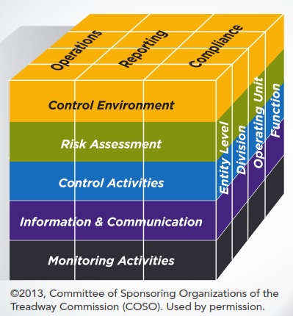
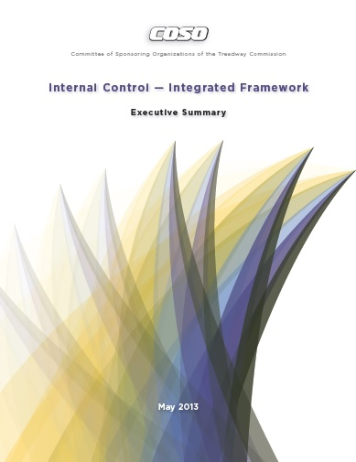
Internal Control and Sustainability Reporting
“The financial reporting objective category is expanded to consider other external reporting beyond financial reporting, as well as internal reporting, both financial and non-financial.”

Slide 22


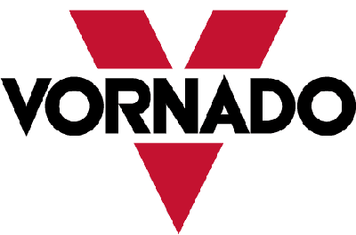






















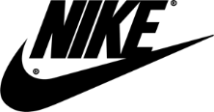







Increasing Signs of Corporate Adoption
Regulatory Filings
Other reporting vehicles (e.g. annual, reports, and sustainability reports, etc.)
Notes:
Mention Ajinomoto and Eisai Chemical mentions of SASB in materiality assessments of their <IR>s

Slide 23

Mandatory ESG Reporting…
A coalition of academics, institutional investors and government officials last October petitioned the agency to spell out what and when companies are required to tell investors about ESG issues. They urged the commission to “initiate rulemaking to develop mandatory rules for public companies to disclose high-quality, comparable, decision-useful [ESG] information.”
The $361.6 billion California Public Employees' Retirement System, Sacramento.
New York state Comptroller Thomas P. DiNapoli.
Illinois Treasurer Michael W. Frerichs.
Connecticut Treasurer Denise L. Nappier.
Oregon Treasurer Tobias Read.
The $2.6 billion Seattle City Employees' Retirement System.
Source: Corporate Secretary, August 2019

Slide 24
The U.S. Congress just held its first hearing on ESG issues – July 2019
"Building a Sustainable and Competitive Economy: An Examination of Proposals to Improve Environmental, Social and Governance Disclosures," was held by the Subcommittee on Investor Protection, Entrepreneurship and Capital Markets
To standardize and embed disclosure that is comprehensive and consistent, Rep. Maloney urged the U.S. Securities and Exchange Commission to establish standards on ESG disclosure that will apply to all public companies in the United States.
Actual legislation is still some way off, but the discussion is indicative of the increasing appetite for greater regulation in ESG disclosure in the United States.

Slide 25


SEC Proposal on Human Capital…
The commission last week proposed rule amendments that would update the description of business, legal proceedings and risk factor disclosures that registrants must make under Regulation SK. One of the proposed changes would include human capital resources as a disclosure topic, including ‘any human capital measures or objectives that management focuses on in managing the business, to the extent such disclosures would be material to an understanding of the registrant’s business.’
Source: Corporate Secretary, August 2019

Slide 26
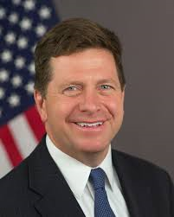
SEC Chair says…
“Our current disclosure requirements date back to a time when companies relied significantly on plant, property and equipment to drive value”
SEC Commissioner Clayton. August 2019

Slide 27
SEC Chair says…
…Clayton said that new amendments would
“modernize and improve our disclosure framework, including recognizing that intangible assets, and in particular human capital, often are a significantly more important driver of value in today’s global economy. The proposals reflect a thoughtful mix of prescriptive and principles-based requirements that should result in improved disclosures and the elimination of unnecessary costs and burdens.”

Slide 28
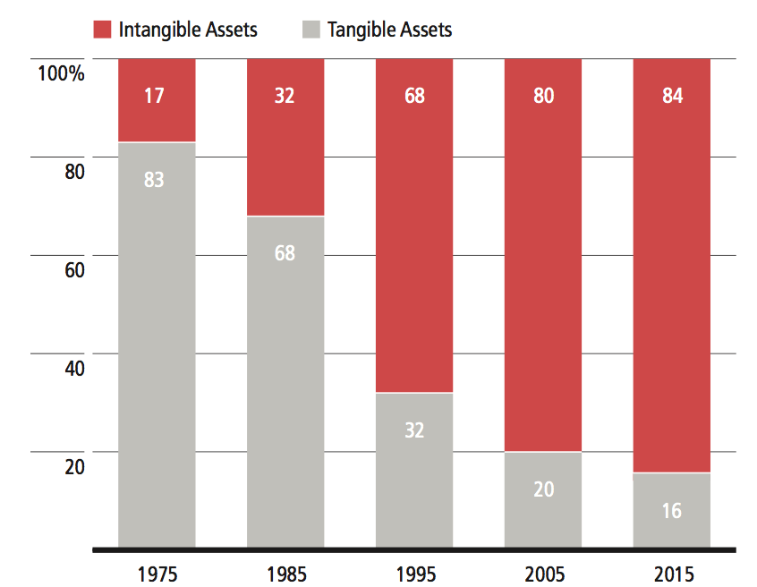
ESG Factors Can Influence Long-Term Risk and Returns
Changing nature of valuations requires broader information set to understand risk
Intangibles, such as intellectual capital, brand value, customer loyalty are increasing components of corporate valuations
Investors are exposed to risks from relatively infrequent, but high impact ESG-related events (e.g. safety incidents, ethics scandals, natural resource shortages)
ESG factors can give forward looking insight into performance and risk
Source: Ocean Tomo, Ocean Tomo’s Intangible Asset Market Value Study, September 2017.

Slide 29
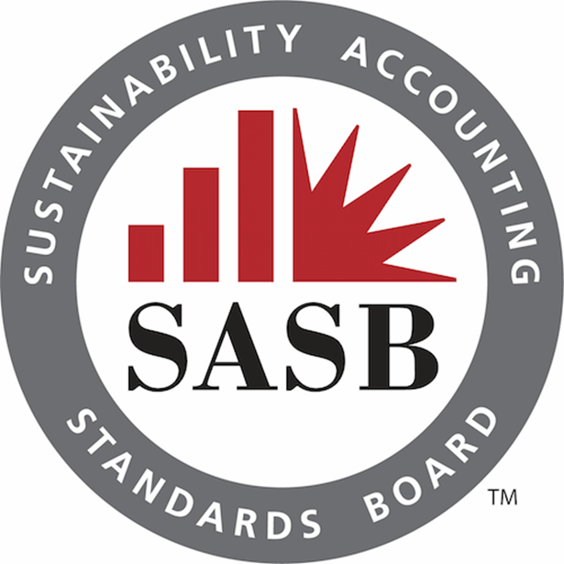


Discussions are Continuing…

Slide 30
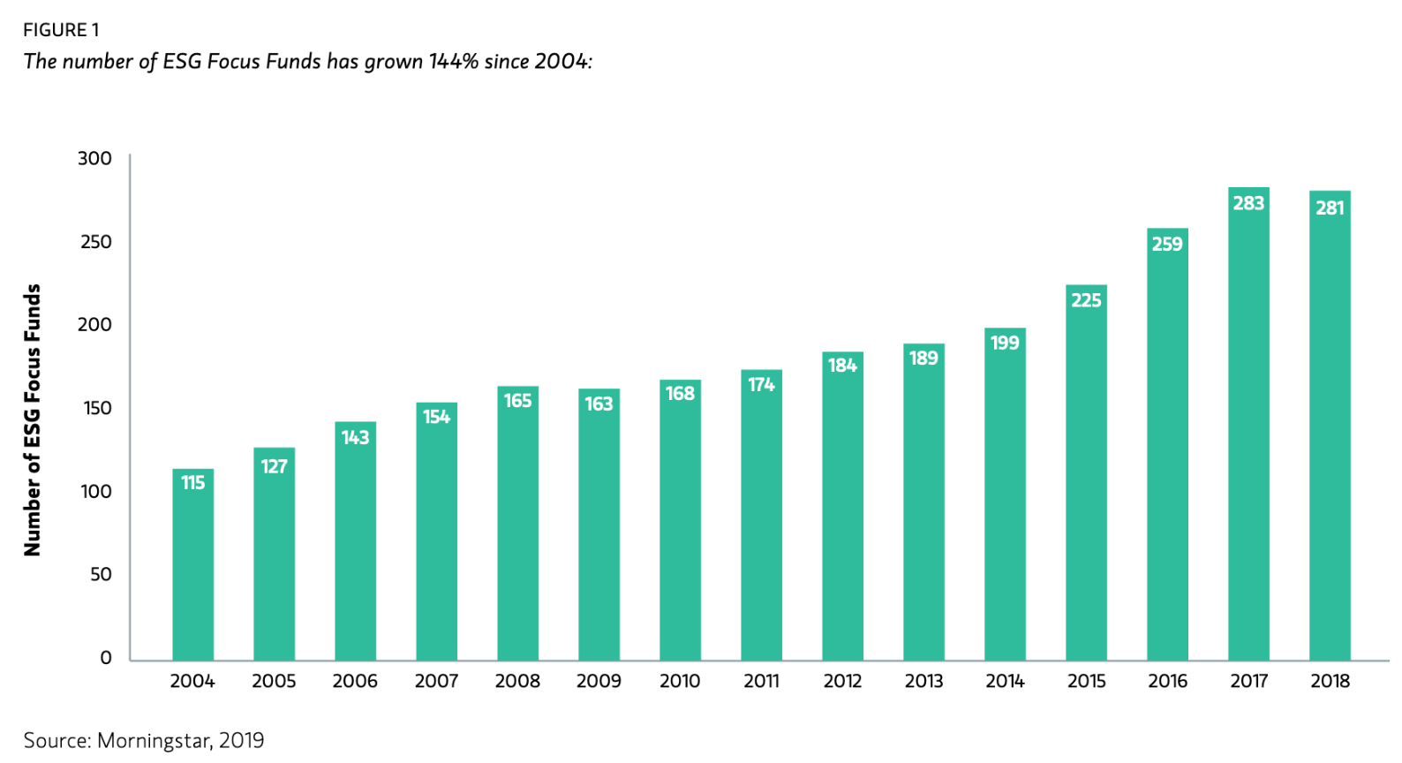
Increasing Number of ESG Funds

Slide 31

Why YOU Might Care, Personally
(not investment advice)
The S&P 500 ESG is the sustainable alternative to a most iconic and widely used benchmark.
So for the first time ever, investors who use the S&P 500 can actually switch to this version and make good on their ESG values without compromising their investment objectives.
By mirroring the risk and return profile of the S&P 500, we’re really dispelling the myth of an ESG performance tradeoff and allowing investors to integrate ESG into the core of their portfolios at very little cost in terms of low tracking error and with comparable returns.

Slide 32


The Elephant in the Room…
If that important to company evaluation and valuation, should the information be subject to some form of management certification and/or some form of third-party verification?

Slide 33

Some Companies Choosing Third Party ESG Assurance
Walgreens Boots
SalesForce
Vornado
Suncor
Southern Company
Etsy
Walmart

Slide 34
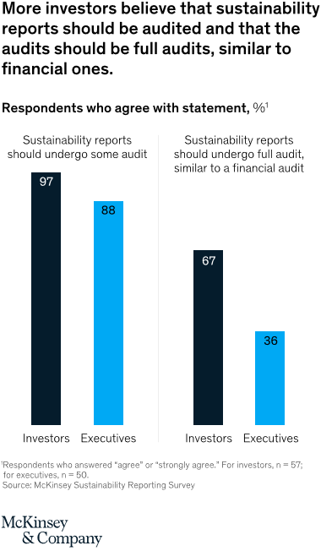

Slide 35

Your Future Work Force Values ESG Activity
“Students want to see employers demonstrate a commitment to socially responsible business practices across all industries”
Wall Street Journal, May 2019

Slide 36

EU Directive on Disclosure of Non-Financial and Diversity Information
The Directive requires 6,000 large European companies to disclose information at least on environmental, social, and employee-related matters, as well as on the respect for human rights, anti-corruption, and bribery issues. These companies also have to disclose the diversity policy for their administrative, management, and supervisory boards.
This Directive represents the most significant EU legislative initiative in respect of such environmental, social and governance disclosure in nearly a decade and is likely to have a significant impact on the non-financial information (NFI) reporting
Large public-interest entities (PIEs) with an average of 500 or more employees will be required to disclose information on several non-financial matters, to the extent necessary for an understanding of the undertaking’s development, performance and position, and of the impact of its activities.
Taking note of this, information must be provided, at a minimum, on:
a. environmental matters
b. social and employee-related matters
c. respect for human rights
d. anti-corruption and bribery matters

Slide 37
Market Push: Heightened Regulatory Focus on Sustainability
Emerging or existing regulations focused on global sustainability-related transparency
Canada
CSA Staff Notice 51-354 Climate Change-related Disclosure Project
EU
EU Action Plan for Financing Sustainable Growth and proposed regulation COM (2018) 353
China
China Securities Regulatory Commission requirements for listed companies to report on environmental risks by 2020
U.S.
Securities and Exchange Commission 2010 Guidance on Climate-related disclosure; 2016 Regulation SK Concept Release inquiry re
disclosure of sustainability information
Japan
Japanese Stewardship Code among Tokyo Stock Exchange listing requirements; requires clear policies from institutional investors on how they fulfill stewardship responsibilities, including on ESG matters.
India
Securities and Exchange Board of India mandated Business Responsibility Reports for top 100 listed companies, based on market capitalization
Indonesia
Financial Services Authority of Indonesia Regulation 51/POJK.03/2017 mandates that annual sustainability reports accompany annual reports.
Brasil
Brasilian Securities and Exchange Commission Rule CVM 480 includes requirement of annual reporting of socio-environmental risk factors and adherence to Code of Best Practices in Corporate Governance
Chile
Chilean Superintendency of Securities and Insurance General Rules No. 385, 386 on improvements in disclosure of governance and sustainability information to shareholders
South Africa
Johannesburg Stock Exchange Listing Requirements – King Code

Slide 38
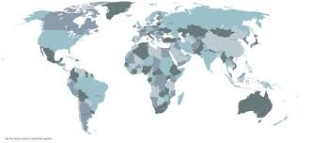


144 Jurisdictions…
“We want companies to report on what is strategically important to them, including how remuneration policies align with their long-term objectives. There will be more focus on intangibles.
And of course, companies will have to tell how sustainability issues, including climate changes, may impact their business if that impact is material.
The work of bodies such as the TCFD may well help them meet the requirements of a Management Commentary here.”
IASB Chair Hans Hoogevorst, April 2019

Slide 39
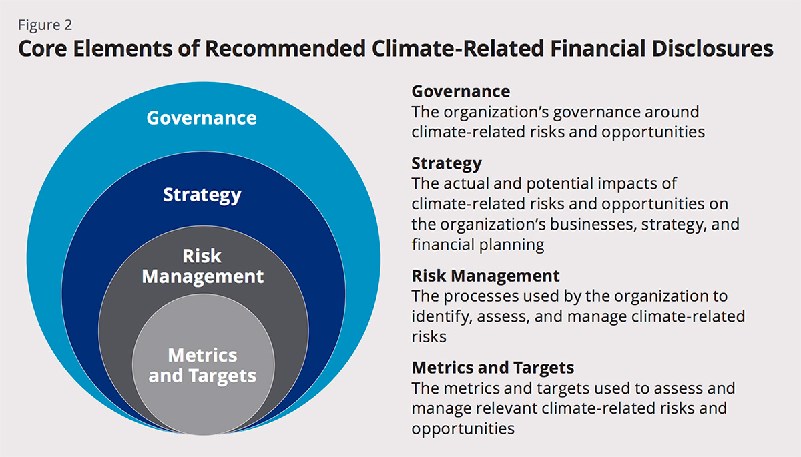

Slide 40

Continuing Legal Advice…
The board and management should also evaluate common ESG reporting guidelines from various organizations and initiatives, including the Sustainability Accounting Standards Board or the Global Reporting Initiative’s Sustainability Reporting Standards, and whether these are standards for success in the company’s ESG disclosure.
As investors look to these sources for information or comparisons, it will be beneficial for a company to disclose whether its measures follow these guidelines or, if not, why such guidelines may not be appropriate for the company due to specific operations or other factors.
The company may consider being upfront in its disclosures about how it measures success and it may be appropriate in some instances to admit that success is an evolving concept.

Slide 41

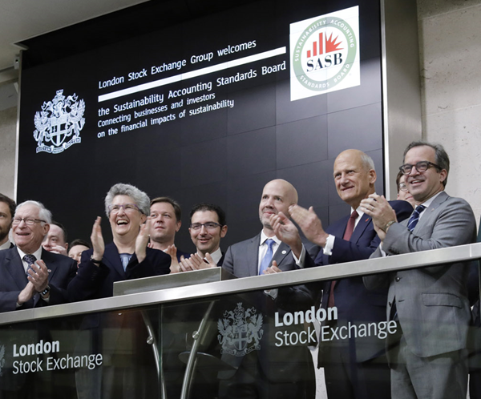
November 7, 2018
The Sustainability Accounting Standards Board (SASB) on Wednesday announced that it has published what it billed as the world’s first set of industry-specific sustainability accounting standards covering financially material issues.
Covering 77 industries, the standards are designed to help businesses better identify and communicate opportunities for sustaining long-term value creation. The standards address the subset of sustainability factors most likely to have financially material impacts on the typical company in an industry and are intended to help investors and companies make more-informed decisions

Slide 42











Industries Grouped by Resource Intensity & Sustainability Impacts
Sustainable Industry Classification System (SICS®): 77 industries within 11 sectors
Consumer Goods
Apparel, Accessories & Footwear
Appliance Manufacturing
Building Products & Furnishings
E-Commerce
Household & Personal Products
Multiline and Specialty Retailers & Distributors
Toys & Sporting Goods
Extractives & Minerals Processing
Coal Operations
Construction Materials
Iron & Steel Producers
Metals & Mining
Oil & Gas - Exploration & Production
Oil & Gas - Midstream
Oil & Gas - Refining & Marketing
Oil & Gas – Services
Financials
Asset Management & Custody Activities
Commercial Banks
Consumer Finance
Insurance
Investment Banking & Brokerage
Mortgage Finance
Security & Commodity Exchanges
Food & Beverage
Agricultural Products
Alcoholic Beverages
Food Retailers & Distributors
Meat, Poultry & Dairy
Non-Alcoholic Beverages
Processed Foods
Restaurants
Tobacco
Health Care
Biotechnology & Pharmaceuticals
Drug Retailers
Health Care Delivery
Health Care Distributors
Managed Care
Medical Equipment & Supplies
Infrastructure
Electric Utilities & Power Generators
Engineering & Construction Services
Gas Utilities & Distributors
Home Builders
Real Estate
Real Estate Services
Waste Management
Water Utilities & Services
Renewable Resources &
Alternative Energy
Biofuels
Forestry Management
Fuel Cells & Industrial Batteries
Pulp & Paper Products
Solar Technology & Project Developers
Wind Technology & Project Developers
Resource Transformation
Aerospace & Defense
Chemicals
Containers & Packaging
Electrical & Electronic Equipment
Industrial Machinery & Goods
Services
Advertising & Marketing
Casinos & Gaming
Education
Hotels & Lodging
Leisure Facilities
Media & Entertainment
Professional & Commercial Services
Technology & Communications
Electronic Manufacturing Services & Original Design Manufacturing
Hardware
Internet Media & Services
Semiconductors
Software & IT Services
Telecommunication Services
Transportation
Air Freight & Logistics
Airlines
Auto Parts
Automobiles
Car Rental & Leasing
Cruise Lines
Marine Transportation
Rail Transportation
Road Transportation
Notes:
SASB’s industry-specific approach is important. Sustainability issues are likely not material for all companies; when they are material, they manifest in unique ways and thus require industry-specific metrics.
SASB maintains standards for 7 industries in 11 sectors.

Slide 43
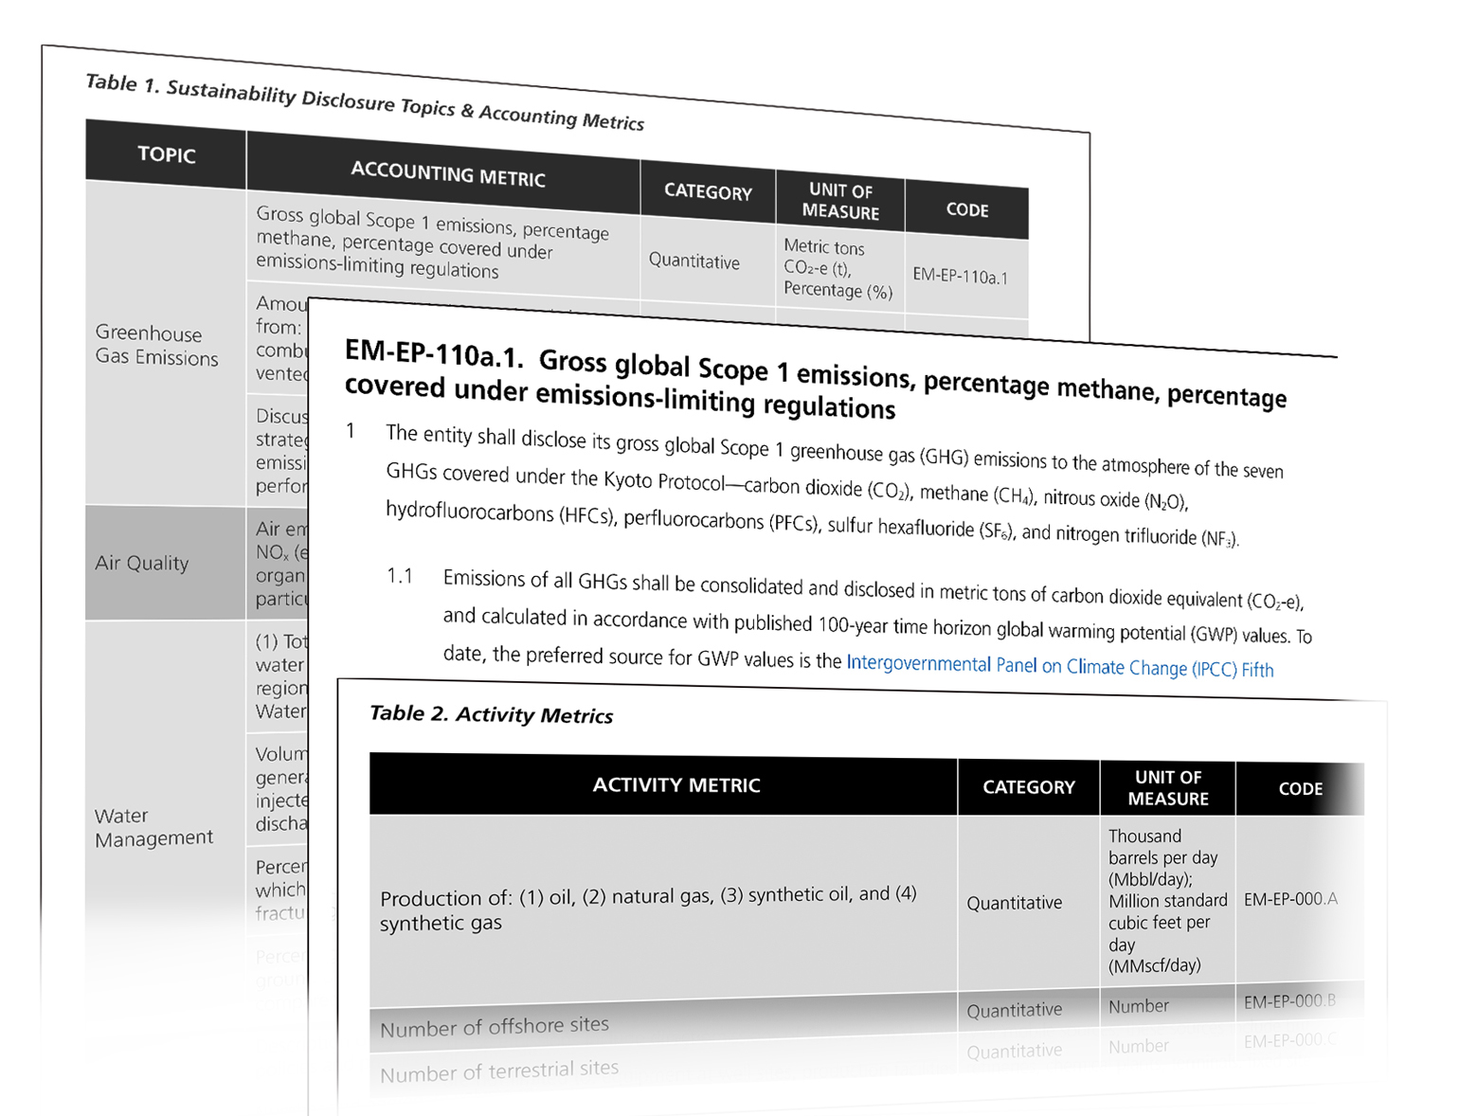
Robust Standards Designed to Provide Decision-Useful Information
SASB standards contain industry-specific disclosure topics, metrics, and guidance
Accounting metrics for each industry-specific disclosure topic
Technical protocol for compiling data
Activity metrics for normalization

Slide 44





Complementary Efforts – GRI
Target sustainability information to specific audiences for specific purposes; SASB focuses on financial materiality for investors
Relevant Information
All environmental, social, and governance topics of interest to a wide range of stakeholders
Sustainability
Report
Broadest Range of Stakeholders
*Some companies include a SASB index to their GRI reports, for ease of investor use
Investor
Communications
Financially Material Data
Sustainability factors reasonably likely to affect the financial condition or operating performance of a company
Investors*
Notes:
To answer investor interest in sustainability-related information, a market standard for its disclosure is necessary, while at the same time addressing the needs of other stakeholders.
SASB standards complement other reporting efforts, but are designed specifically for use in SEC filings, and by issuers to communicate material information to investors.

Slide 45



























Institutional Investor Support for Improved ESG Disclosure
SASB’s Investor Advisory Group includes investors with over $26 trillion in assets
The SASB Investor Advisory Group (IAG) comprises leading asset owners and asset managers who recognize the need for consistent, comparable and reliable disclosure of material, decision-useful ESG information.

Slide 46
SASB Application Guidance…
5.0 Governance, Internal Control, and Assurance
Disclosure to investors should be accurate and reliable. Accordingly, a reporting entity should design, implement, and maintain a system of governance around developing and disclosing sustainability information—including management involvement, board oversight, and internal control—that is substantially similar to what it uses for financial reporting.
Furthermore, SASB standards are designed to serve as a basis for suitable criteria if an entity chooses to seek third-party assurance.

Slide 47


COSO Framework and Sustainability
Leveraging the COSO Internal Control – Integrated Framework to Improve Confidence in Sustainability Performance Data

Slide 48
The SASB Difference
SASB standards are created for the market, by the market
Material
Decision-Useful
Cost-Effective
Industry-Specific
Evidence-Based
Market-Informed
© 2017 SASB™

Slide 49

There’s Only One…

